Slide 1
Onshore/Offshore ILP Mandate Market Snapshot
Onshore ILP Mandate Wallet
(1.) Share by site – (Top 20)
(2.) Share by account – ( Top 50 , on/off AIA List )
(3.) Detail Account Excel Sheet – (channel , customer , account , fund type … etc)
Offshore ILP Mandate Wallet
(1.) Share by site – (Top 15)
(2.) Share by account – ( Top 50, on/off AIA List )
(3.) Detail Account Excel Sheet – (channel , customer , account , fund type … etc)

Slide 2
Onshore ILP Mandate Market Snapshot – By Site

Slide 3
Onshore ILP Mandate Wallet Share by SITE
Among the top 19 SITEs with ILP mandate business listed in AIA meeting, we have approximate 7% of wallet share in total. Total AUM is NTD 10,959 mn.
AIA List
 | SITE | # of account | Contract size (TWD mn) | DB AUM (as of June) | DB % | Reason for 0% wallet share
1 | Fuh Hwa SITE | 24 | 68,979 | 7,009 | 10%
2 | Allianz SITE | 6 | 19,557 | 1,165 | 6%
3 | Yuanta SITE | 4 | 15,028 | 6 | 0%
4 | AB SITE | 3 | 9,703 | 0 | 0% | No third party fund allocation
5 | Franklin SITE | 3 | 6,043 | 521 | 9%
6 | Cathay SITE | 1 | 5,815 | 0 | 0% | Brand name issues unresolved, but already build connection with chairman
7 | Capital SITE | 6 | 5,666 | 965 | 17%
8 | Manulife SITE | 3 | 5,661 | 180 | 3%
9 | Fubon SITE | 3 | 3,715 | 505 | 14%
10 | TCB SITE | 2 | 2,774 | 403 | 15%
11 | CTBC SITE | 2 | 2,687 | 150 | 6%
12 | Pinebridge SITE | 1 | 1,160 | 0 | 0% | Positions temporarily redeemed for trading purpose.
13 | Eastspring SITE | 1 | 1,072 | 0 | 0% | Mainly allocate in in-house onshore funds.
14 | Uni-President SITE | 1 | 970 | 0 | 0% | Positions temporarily redeemed for trading purpose.
15 | Schroders SITE | 2 | 693 | 0 | 0% | No third party fund allocation
17 | KGI SITE | 2 | 409 | 43 | 11%
18 | First Securities SITE | 1 | 128 | 12 | 9%
19 | Taishin SITE | 2 | 64 | 0 | 0% | a/c opned in May. New positions are not counted in.
Total |  |  | 150,124 | 10,959 | 7%
Web Data(公會)
SA Data
Notes:
Contract size → ( 投信投顧公會資料 )

Slide 4
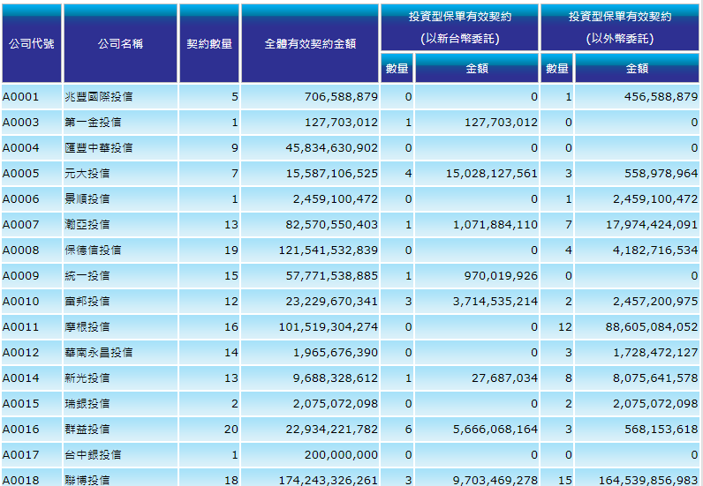


Web Data – (公會)
Select Date

Slide 5
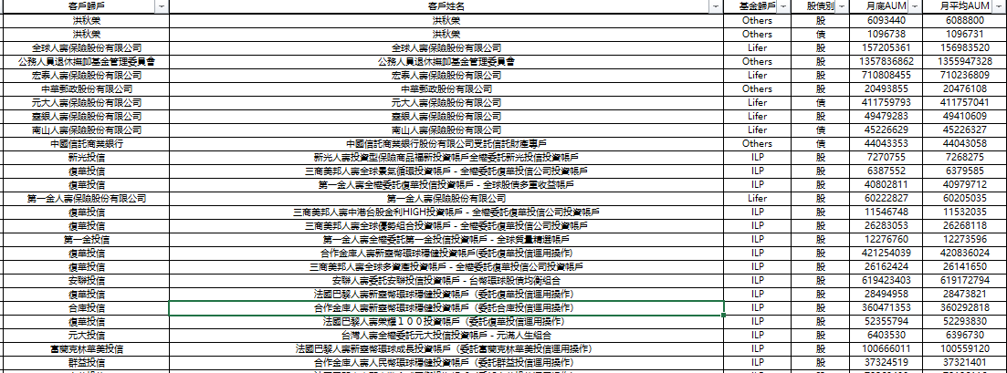
Detail Account Excel Sheet - (SA data)
依客戶拆報表
(客戶歸戶)
ILP
(基金歸戶)
月底AUM相加
DB AUM

Slide 6
Onshore ILP Mandate Wallet Share by SITE
公司名稱 | 投資型保單有效契約-數量(新台幣) | 投資型保單有效契約-金額(新台幣) | DB AUM | DB %
復華投信 | 24 | 68,978,968,702 | 7,009,105,494 | 10.16
安聯投信 | 6 | 19,556,694,110 | 1,165,622,550 | 5.96
元大投信 | 4 | 15,028,127,561 | 6,403,530 | 0.04
聯博投信 | 3 | 9,703,469,278 | - | 0
富蘭克林華美投信 | 3 | 6,043,052,262 | 521,189,903 | 8.62
國泰投信 | 1 | 5,814,655,590 | - | 0
群益投信 | 6 | 5,666,068,164 | 965,270,841 | 17.04
宏利投信 | 3 | 5,661,145,319 | 180,673,747 | 3.19
富邦投信 | 3 | 3,714,535,214 | 505,095,109 | 13.6
合庫投信 | 2 | 2,774,032,982 | 403,526,972 | 14.55
中國信託投信 | 2 | 2,687,142,770 | 150,159,228 | 5.59
柏瑞投信 | 1 | 1,159,530,789 | - | 0
瀚亞投信 | 1 | 1,071,884,110 | - | 0
統一投信 | 1 | 970,019,926 | - | 0
施羅德投信 | 2 | 692,937,726 | - | 0
野村投信 | 1 | 646,468,265 | - | 0
凱基投信 | 2 | 408,681,708 | 43,443,478 | 10.63
第一金投信 | 1 | 127,703,012 | 12,276,760 | 9.61
台新投信 | 2 | 64,276,516 | - | 0
新光投信 | 1 | 27,687,034 | 7,270,755 | 26.26
Reason
Web Data
SA Data

Slide 7
Onshore ILP Mandate Market Snapshot – By Account

Slide 8
Onshore ILP mandate Wallet share – On AIA List
We’ve penetrated all the top 17 ILP contracts listed in AIA meeting and had approximate 9% of wallet share in total. Total AUM is NTD 9,179mn.
AIA List
Account | AUM 2021/3/1 | DB AUM (as of June 9) | DB %
南山人壽委託復華投信投資帳戶-新臺幣精選平衡型(現金撥回) | 47,576 | 5,808 | 12%
合作金庫人壽新臺幣環球穩健投資帳戶(委託復華投信運用操作)-轉投入 | 7,240 | 421 | 6%
臺銀人壽委託復華投信投資帳戶-新台幣精選平衡型 | 2,176 | 153 | 7%
安聯人壽委託復華投信投資帳戶-豐收得利2(月撥回資產) | 1,961 | 52 | 3%
法國巴黎人壽新臺幣全球平衡投資帳戶(委託復華投信運用操作)-月撥現 | 1,559 | 78 | 5%
安聯人壽委託德盛安聯投信投資帳戶-台幣環球股債均衡組合(月撥回資產) | 9,259 | 619 | 7%
富邦人壽委託安聯投信-優享退月提解全權委託投資帳戶(現金撥回) | 4,157 | 30 | 1%
三商美邦人壽鑫穩健投資帳戶(現金撥回) | 3,560 | 430 | 12%
合作金庫人壽新臺幣環球穩健投資帳戶(委託安聯投信運用操作)-轉投入 | 1,238 | 25 | 2%
台灣人壽委託群益投信投資帳戶-安鑫增益投資帳戶(新臺幣) | 2,797 | 491 | 18%
全球人壽優選樂退投資帳戶 | 1,370 | 390 | 28%
*保誠人壽全權委託富蘭克林華美投信投資帳戶-新臺幣股債平衡收益帳戶 | 3,649 | 298 | 8%
*法國巴黎人壽新臺幣環球成長投資帳戶(委託富蘭克林華美投信運用操作) | 2,042 | 101 | 5%
*安聯人壽委託富蘭克林華美投信投資帳戶_新臺幣多元收益 | 1,700 | 122 | 7%
保誠人壽全權委託宏利投信投資帳戶-亞洲亮點收益帳戶 | 2,741 | 74 | 3%
**台灣人壽台幣代操帳戶(成長型) | 2,226 | 54 | 2%
**台灣人壽委託宏利投信-台幣投資帳戶(成長型)(二) | 1,865 | 33 | 2%
Total | 97,116 | 9,179 | 9%
Unit : NTD mn. Sorting by AUM as of 2021/3/1.
Source : SA. Data is as of June 9
Notes:
AUM (公會資料)

Slide 9
Onshore ILP mandate Wallet share – Not On AIA List
Beside the contracts on AIA list, we have about NT 1,789mn of AUM contributed by 31 ILP contracts which are not showing on the AIA list.
Account Name | AUM Subtotal
台北富邦商業銀行受託保管富邦人壽投資型保險商品投資專戶全權委託富邦投信投資帳戶－Acc5 | 446,024,788
合作金庫人壽新臺幣環球穩健投資帳戶（委託合庫投信運用操作） | 360,471,353
台灣人壽委託中國信託投信投資帳戶—波動防禦型目標收益帳戶（新台幣） | 150,159,228
法國巴黎人壽新臺幣台灣新益投資帳戶（委託復華投信運用操作）－月撥現 | 133,918,420
台北富邦商業銀行受託保管富邦人壽投資型保險商品投資專戶全權委託富邦投信投資帳戶－Acc3 | 59,070,321
法國巴黎人壽榮耀１００投資帳戶（委託復華投信運用操作） | 52,355,794
安聯人壽委託群益投信投資帳戶－台幣環球股債收益組合（雙月撥回） | 47,061,223
安聯人壽委託復華投信投資帳戶─台幣環球股債均衡組合〈雙月撥回〉 | 44,546,380
安達人壽全權委託凱基投信環球多元動態組合投資帳戶 | 43,443,478
合作金庫人壽新臺幣全球平衡投資帳戶〈委託合庫投信運用操作〉 | 43,055,619
第一金人壽全權委託復華投信投資帳戶－全球股債多重收益帳戶 | 40,802,811
安達人壽全權委託復華投信代操全球贏新投資組合－月撥回（現金）投資帳戶 | 40,517,691
合作金庫人壽人民幣環球穩健投資帳戶（委託群益投信運用操作） | 37,324,519
法國巴黎人壽新臺幣全球資產投資帳戶（委託復華投信運用操作） | 32,230,259
安聯人壽委託安聯投信投資帳戶－台幣全球動能收益組合（月撥回） | 31,214,479
法國巴黎人壽新臺幣環球穩健投資帳戶（委託安聯投信運用操作）－累積 | 29,264,198
法國巴黎人壽新臺幣環球穩健投資帳戶（委託復華投信運用操作） | 28,494,958
三商美邦人壽全球優勢組合投資帳戶－全權委託復華投信公司投資帳戶 | 26,283,053
三商美邦人壽全球多資產投資帳戶－全權委託復華投信公司投資帳戶 | 26,162,424
法國巴黎人壽新臺幣台灣新益投資帳戶（委託復華投信運用操作）－累積 | 21,967,586
合作金庫人壽新臺幣全球資產投資帳戶（委託復華投信運用操作） | 16,476,835
第一金人壽全權委託第一金投信投資帳戶－全球質量精選帳戶 | 12,276,760
台灣人壽委託宏利投信—台幣投資帳戶（價值型）（一） | 11,970,329
三商美邦人壽中港台股金利HIGH投資帳戶－全權委託復華投信公司投資帳戶 | 11,546,748
台灣人壽委託宏利投信—台幣投資帳戶（價值型）（ＩＩ） | 7,470,728
新光人壽投資型保險商品福新投資帳戶全權委託新光投信投資帳戶 | 7,270,755
台灣人壽全權委託元大投信投資帳戶－元滿人生組合 | 6,403,530
三商美邦人壽全球景氣循環投資帳戶－全權委託復華投信公司投資帳戶 | 6,387,552
安達人壽全權委託復華投信代操全球贏新投資組合－累積投資帳戶 | 5,083,441
三商美邦人壽新臺幣永續豐收投資帳戶－全權委託復華投信公司投資帳戶 | 4,897,090
三商美邦人壽三陽得利投資帳戶－全權委託復華投信公司投資帳戶 | 4,743,836
Total | 1,788,896,186
Source : SA. Data is as of June 9
Notes:
AIA list ?

Slide 10
Onshore ILP mandate Wallet share (Top 50)
Index | 客戶姓名 | DB AUM
0 | 南山人壽委託復華投信投資帳戶－新臺幣精選平衡型 | 5,807,642,827
1 | 富邦人壽保險股份有限公司 | 1,707,674,425
2 | 公務人員退休撫卹基金管理委員會 | 1,357,836,862
3 | 臺灣銀行股份有限公司公教保險部 | 1,194,271,981
4 | 宏泰人壽保險股份有限公司 | 710,808,455
5 | 安聯人壽委託安聯投信投資帳戶－台幣環球股債均衡組合 | 619,423,403
6 | 台灣人壽委託群益投信投資帳戶—安鑫增益投資帳戶（新台幣） | 491,214,091
7 | 台北富邦商業銀行受託保管富邦人壽投資型保險商品投資專戶全權委託富邦投信投資帳戶－Acc5 | 446,024,788
8 | 三商美邦人壽鑫穩健投資帳戶－全權委託安聯投信投資帳戶 | 430,450,329
9 | 合作金庫人壽新臺幣環球穩健投資帳戶(委託復華投信運用操作) | 421,254,039
10 | 元大人壽保險股份有限公司 | 411,759,793
11 | 全球人壽優選樂退投資帳戶〈委託群益投信運用操作〉 | 389,671,008
12 | 合作金庫人壽新臺幣環球穩健投資帳戶（委託合庫投信運用操作） | 360,471,353
13 | 遠雄人壽保險事業股份有限公司 | 299,533,774
14 | 保誠人壽全權委託富蘭克林華美投信投資帳戶－新臺幣股債平衡收益帳戶 | 297,699,990
15 | 遠東國際商業銀行股份有限公司受託保管復華台灣智能證券投資信託基金專戶 | 201,379,448
16 | 華南商業銀行受託保管群益全民退休組合傘型證券投資信託基金之群益全民成長樂退組合證券投資信託基金專戶 | 170,742,930
17 | 全球人壽保險股份有限公司 | 157,205,361
18 | 臺銀人壽委託復華投信投資帳戶－新臺幣精選平衡型 | 153,747,171
19 | 台灣人壽委託中國信託投信投資帳戶—波動防禦型目標收益帳戶（新台幣） | 150,159,228
20 | 台灣人壽保險股份有限公司 | 149,332,268
21 | 蔡雪美全權委託安聯投信公司投資帳戶 | 135,510,242
22 | 法國巴黎人壽新臺幣台灣新益投資帳戶（委託復華投信運用操作）－月撥現 | 133,918,420
23 | 安聯人壽委託富蘭克林華美投信投資帳戶_新臺幣多元收益(月撥回) | 122,823,902
24 | 法國巴黎人壽新臺幣環球成長投資帳戶（委託富蘭克林華美投信運用操作） | 100,666,011
25 | 法國巴黎人壽新臺幣全球平衡投資帳戶（委託復華投信運用操作） | 78,269,430
By Contract
月底AUM相加
Contract Size排序

Slide 11
Offshore ILP Mandate Market Snapshot – By Site

Slide 12
Offshore ILP Mandate Wallet Share by SITE
Due to the limited offering of pure i-share for institutional clients in the past, among the top 15 SITEs with ILP mandate business listed in AIA meeting, we have only 0.3% of wallet share in total. Total AUM is NTD 2,254 mn. We will keep pushing the account opening of NN ishare to increase our wallet share for offshore ILP mandate.
AIA List
Rank | SITE | Contract size | DB Total | DB% | NAMU | NN(L) | Ninetyone | Reason for 0% wallet share
1 | Cathay SITE | 200,903 | 0 | 0% | 0 | 0 | 0 | Brand name issue, but already build connection with its chairman to explore a/c opening oppootunity.
2 | AB SITE | 164,540 | 0 | 0% | 0 | 0 | 0 | No third party fund allocation
3 | JPM SITE | 88,605 | 0 | 0% | 0 | 0 | 0
4 | Schroders SITE | 61,869 | 0 | 0% | 0 | 0 | 0
5 | Fidelity SITE | 45,908 | 0 | 0% | 0 | 0 | 0
6 | Franklin SITE | 29,341 | 766 | 3% | 0 | 35 | 731
7 | Blackrock SITE | 25,279 | 0 | 0% | 0 | 0 | 0 | No third party fund allocation
8 | Eastspring SITE | 17,974 | 1,008 | 6% | 1,008 | 0 | 0
9 | CTBC SITE | 15,681 | 0 | 0% | 0 | 0 | 0 | Mainly allocate in ETFs
10 | Allianz SITE | 15,675 | 0 | 0% | 0 | 0 | 0 | Positions temporarily redeemed/ new a/c opening is underway
11 | Fuh Hwa SITE | 13,203 | 480 | 4% | 0 | 90 | 389
12 | Manulife SITE | 10,283 | 0 | 0% | 0 | 0 | 0 | Positions temporarily redeemed/ new a/c opening is underway
13 | Shin Kong SITE | 8,076 | 0 | 0% | 0 | 0 | 0 | Mainly allocate in ETFs
14 | Pinebridge SITE | 5,916 | 0 | 0% | 0 | 0 | 0 | Positions temporarily redeemed
15 | Taishin SITE | 5,600 | 0 | 0% | 0 | 0 | 0 | Mainly allocate in ETFs
Total |  | 708,853 | 2,254 | 0.3% | 1,008 | 125 | 1,120
Web Data(公會)
SA Data
Unit : TWD mn. Sorting by contract size.
Source : SA. Data is as of June 9. FX rate:28.
Notes:
Site 的 data

Slide 13
Web Data
Select Date

Slide 14
Detail Account Excel Sheet - (SA data)
依客戶拆報表
(客戶歸戶)
ILP
(基金歸戶)
月底AUM相加 * 28(匯率)
DB AUM

Slide 15
Offshore ILP Mandate Wallet Share by SITE – (Top 15)
公司名稱 | 投資型保單有效契約-數量(外幣) | 投資型保單有效契約-金額(外幣) | DB AUM | DB % | IAM | NAMU | NN
國泰投信 | 14 | 200,903,017,218 | - | - | - | - | -
聯博投信 | 15 | 164,539,856,983 | - | - | - | - | -
摩根投信 | 12 | 88,605,084,052 | - | - | - | - | -
施羅德投信 | 15 | 61,869,206,030 | - | - | - | - | -
富達投信 | 12 | 45,908,333,484 | - | - | - | - | -
富蘭克林華美投信 | 45 | 29,340,651,220 | 758,686,424 | 3 | 25,834,312 | - | 1,680,014
貝萊德投信 | 12 | 25,278,532,617 | - | - | - | - | -
瀚亞投信 | 7 | 17,974,424,091 | 1,247,754,500 | 7 | 4,648,693 | 39,913,968 | -
中國信託投信 | 8 | 15,680,835,021 | - | - | - | - | -
安聯投信 | 7 | 15,674,737,795 | - | - | 11,244,018 | 25,870,245 | 5,219,437
復華投信 | 16 | 13,203,361,689 | 471,346,193 | 4 | 22,211,877 | 18,616,602 | 7,073,163
宏利投信 | 5 | 10,283,462,654 | - | - | - | - | -
新光投信 | 8 | 8,075,641,578 | - | - | - | - | -
柏瑞投信 | 5 | 5,915,734,728 | - | - | - | - | 390,133
台新投信 | 11 | 5,600,216,566 | - | - | - | - | -
Web Data (公會)
SA Data

Slide 16
Offshore ILP Mandate Market Snapshot – By Account

Slide 17
Offshore ILP mandate Wallet share – On AIA List
Among the top 22 ILP contracts listed in AIA meeting, we have approximate 2% of wallet share in total. Total AUM is USD 68.4mn.
AIA List
Account | 2021/4/1 AUM | DB Total | DB% | NAMU | NN (L) | Ninety One
富邦人壽委託富蘭克林華美投信–目標收益優利組合月提解全權委託投資帳戶(現金撥回) | 408.5 | 0 | 0% | 0 | 0 | 0
南山人壽委託復華投信投資帳戶-美元精選平衡型(現金撥回) | 339.7 | 11 | 3% | 0 | 0 | 11
富邦人壽委託安聯投信-目標收益穩健組合月提解全權委託投資帳戶(現金撥回) | 332 | 0 | 0% | 0 | 0 | 0
瀚亞新收益全權委託管理帳戶(美元) | 322.1 | 29.0 | 9% | 29.0 | 0 | 0
中國信託投信全委代操美歐動態策略價值投資組合 | 302.1 | 0 | 0% | 0 | 0 | 0
中國人壽瀚亞享鑫全權委託管理帳戶(美元) | 244.6 | 0 | 0% | 0 | 0 | 0
**台灣人壽委託中國信託投信投資帳戶 -趨勢動能投資帳戶(美元) | 164.9 | 0 | 0% | 0 | 0 | 0
安聯人壽委託富蘭克林華美投信投資帳戶-穩健成長型(月撥回資產) | 127 | 0 | 0% | 0 | 0 | 0
安聯人壽委託安聯投信投資帳戶-智慧平衡組合(月撥回資產)-X | 99.8 | 0 | 0% | 0 | 0 | 0
法國巴黎人壽風險管理策略投資帳戶(委託中國信託投信運用操作)-月撥現⁽¹⁾ | 74.3 | 0 | 0% | 0 | 0 | 0
安聯人壽委託瀚亞投信投資帳戶-收益優化 | 73.8 | 7.0 | 9% | 7.0 | 0 | 0
富邦人壽月月收益月提解全權委託投資帳戶(現金撥回) | 63.4 | 0 | 0% | 0 | 0 | 0
安聯人壽委託瀚亞投信投資帳戶-收益升級(月撥回) | 54.2 | 0 | 0% | 0 | 0 | 0
合作金庫人壽環球穩健投資帳戶(委託富蘭克林華美投信運用操作)-轉投入 | 51.4 | 3.0 | 6% | 0 | 0 | 3.0
法國巴黎人壽環球成長投資帳戶(委託富蘭克林華美投信運用操作)-月撥現 | 49.9 | 0 | 0% | 0 | 0 | 0
安達人壽復華投信全委代操戰略贏家價值投資組合 - 月撥回 ( 現金 ) | 45.7 | 0 | 0% | 0 | 0 | 0
中國人壽瀚亞享富全權委託管理帳戶(美元) | 41 | 0 | 0% | 0 | 0 | 0
法國巴黎人壽多重資產投資帳戶(委託富蘭克林華美投信運用操作)-月撥現 | 40.6 | 16.8 | 41% | 0 | 0 | 16.8
安聯人壽委託富蘭克林華美投信投資帳戶_精選收益型(月撥回)美元計價 | 36.8 | 1.6 | 4% | 0 | 0 | 1.6
法國巴黎人壽智慧收益投資帳戶(委託安聯投信運用操作)-月撥現 | 35.9 | 0 | 0% | 0 | 0 | 0
法國巴黎人壽動態智慧ETF投資帳戶(委託中國信託投信運用操作) -累積⁽²⁾ | 32.4 | 0 | 0% | 0 | 0 | 0
安聯人壽委託富蘭克林華美投信投資帳戶-美元環球股債均衡組合(月撥回資產) | 30.9 | 0 | 0% | 0 | 0 | 0
Total | 2,971 | 68.4 | 2% | 36 | 0 | 32.4
Unit : USD mn.
Source : SA. Data is as of June 9

Slide 18
Offshore ILP mandate Wallet share – Not On AIA List
Beside the contracts on AIA list, we have about USD 17.8mn of AUM contributed by 13 ILP contracts which are not showing on the AIA list
Account name | Subtotal | NAMU | NN(L) | Ninety One
宏泰人壽樂活人生積極型全權委託街口投信帳戶 | 3,536,066 |  |  | 3,536,066
法國巴黎人壽全球資產投資帳戶(委託復華投信運用操作) | 3,441,912 |  | 2,770,463 | 671,448
安聯人壽委託富蘭克林華美投信投資帳戶_精選收益型(月撥回)澳幣計價 | 3,162,219 |  |  | 3,162,219
安聯人壽委託復華投信投資帳戶-美元環球股債均衡組合(雙月撥回) | 1,965,439 | - |  | 1,965,439
新光人壽投資型保險商品鑫富發投資帳戶全權委託富蘭克林華美投信投資帳戶 | 1,453,345 |  |  | 1,453,345
富蘭克林華美亞太龍贏多元收益全權委託管理帳戶-中國人壽 | 1,260,026 |  | 1,260,026
台北富邦商業銀行受託保管富邦人壽投資型保險商品投資專戶全權委託富邦投信投資帳戶-Acc2 | 851,572 |  |  | 851,572
安聯人壽委託復華投信投資帳戶-環球精選-美元 | 702,515 |  | 453,389 | 249,126
安達人壽全權委託合庫投信全委代操雙享利投資帳戶 | 577,784 |  |  | 577,784
台北富邦商業銀行受託保管富邦人壽投資型保險商品投資專戶全權委託富邦投信投資帳戶-Acc1 | 364,959 |  |  | 364,959
法國巴黎人壽環球穩健投資帳戶(委託群益投信運用操作) | 281,904 |  |  | 281,904
合作金庫人壽環球穩健投資帳戶(委託合庫投信運用操作) | 149,784 | 38,497 |  | 111,287
法國巴黎人壽環球穩健投資帳戶(委託富蘭克林華美投信運用操作) | 103,014 |  |  | 103,014
Total | 17,850,539 | 38,497 | 4,483,878 | 13,328,164
Unit : USD mn.
Source : SA. Data is as of June 9
Notes:
右邊 3 個 ins , data?

Slide 19
Offshore ILP mandate Wallet share – TOP 50 Account
index | 客戶姓名 | DB AUM | NAMU | NN | IAM
0 | 三商美邦人壽寰宇多資產投資帳戶-全權委託復華投信公司投資帳戶 | 2,681,961 | - | 1,821,697 | 860,264
1 | 上海商業銀行-復華高益策略組合基金 | 16,828,488 | - | - | 16,828,488
2 | 保德信國際人壽投資型保單固定收益帳戶全權委託保德信投信投資帳戶 | 136,241,608 | - | 136,241,608 | -
3 | 保德信好時債組合證券投資信託基金 | 1,261,632 | - | - | -
4 | 勞工保險基金 | 7,042,432 | 7,042,432 | - | -
5 | 南山人壽保險股份有限公司 | 833,733 | - | - | 833,733
6 | 南山人壽委託復華投信投資帳戶-美元精選平衡型 | 5,432,217 | - | 5,219,437 | 212,780
7 | 台北富邦商業銀行受託保管富邦人壽投資型保險商品投資專戶全權委託富邦投信投資帳戶-Acc1 | 632,433 | - | - | 632,433
8 | 台北富邦商業銀行受託保管富邦人壽投資型保險商品投資專戶全權委託富邦投信投資帳戶-Acc2 | 70,221 | - | - | 70,221
9 | 台灣銀行受託保管聯邦優勢策略全球債券組合證券投資信託基金專戶 | 1,023,199 | - | 1,023,199 | -
10 | 台灣銀行股份有限公司公教保險部 | 9,961,767 | - | - | 9,961,767
11 | 合作金庫人壽澳幣環球穩健投資帳戶(委託合庫投信運用操作) | 20,791,732 | - | - | 20,791,732
12 | 合作金庫人壽環球穩健投資帳戶(委託合庫投信運用操作) | 407,072 | 38,388 | - | 368,685
13 | 合作金庫人壽環球穩健投資帳戶(委託富蘭克林華美投信運用操作) | 42,710 | - | - | 42,710
14 | 合作金庫受託保管群益全民優質樂退組合證券投資信託基金專戶 | 6,888,580 | - | - | 6,888,580
15 | 合作金庫商業銀行受託保管統一全球債券組合証券投資信託基金 | 215,659 | - | 215,659 | -
16 | 合庫多元入息組合基金 | 3,110,019 | - | 3,110,019 | -
17 | 合庫巴黎新興多重收益組合基金 | 4,266,259 | - | 2,770,453 | 1,495,806
18 | 國民年金保險基金 | 3,138,736 | 3,138,736 | - | -
19 | 國泰人壽保險股份有限公司 | 29,448,283 | - | 26,340,946 | 3,107,337
20 | 安聯人壽委託富蘭克林華美投信投資帳戶_精選收益型(月撥回)澳幣計價 | 100,908 | - | - | 100,908
21 | 安聯人壽委託富蘭克林華美投信投資帳戶_精選收益型(月撥回)美元計價 | 660,839 | - | - | 660,839
22 | 安聯人壽委託復華投信投資帳戶-環球精選-美元 | 7,572,778 | - | 1,979,611 | 5,593,167
23 | 安聯人壽委託復華投信投資帳戶-美元環球股債均衡組合(雙月撥回) | 4,400,524 | 197,371 | 454,207 | 3,748,946
24 | 安聯人壽委託瀚亞投信投資帳戶-收益優化 | 6,948,383 | 6,948,383 | - | -

Slide 20
Possible Solution for
Lifer’s ILP Account Detail Information

Slide 21
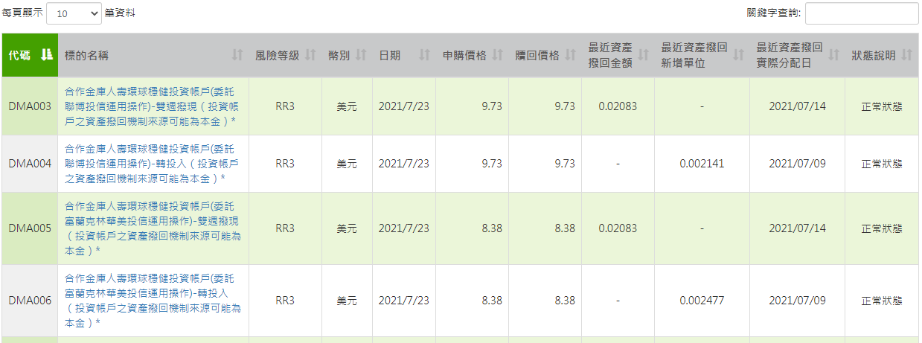
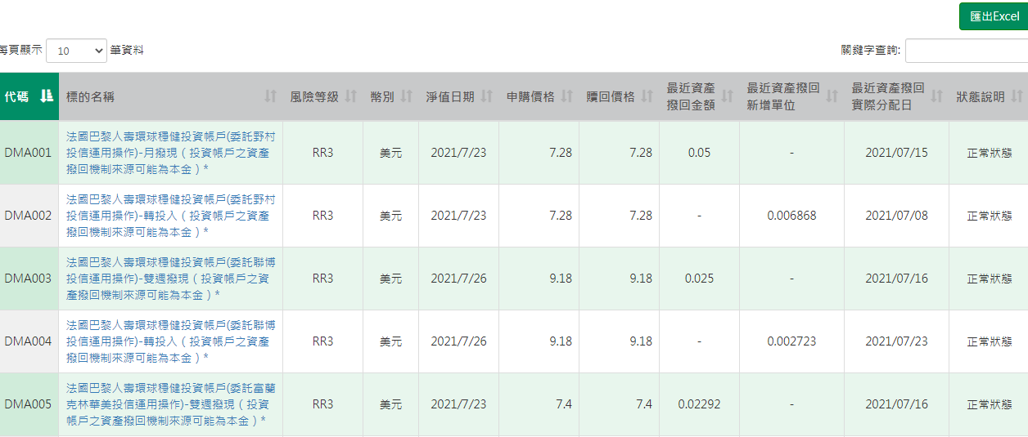
ILP Account
合作金庫人壽
法國巴黎人壽

Slide 22
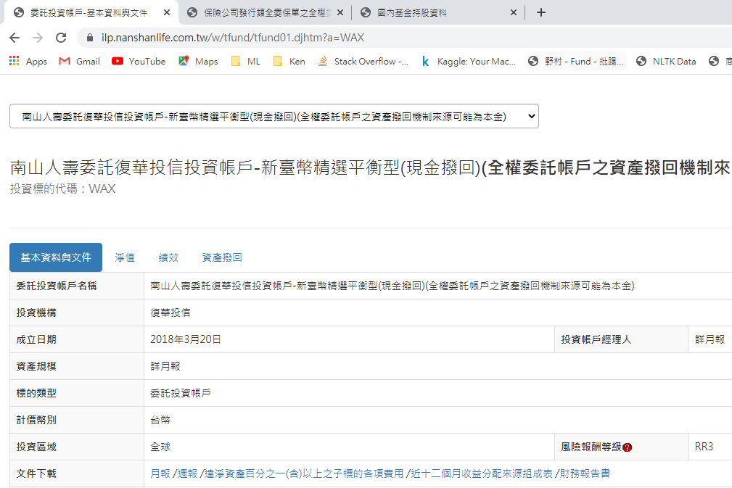

ILP Account
南山人壽
富邦人壽

Slide 23
Possible Solution
1. For every Lifer’s website(19) → A Web Crawler , Automatically Download PDF
2. Manually Key in Data to excel ( Current Account AUM ,Top 5 Holding Funds )
3. Python or Excel Data Processing , For further Market Analysis

Slide 24
Solution Concern
1. 19 different webs → 19 web crawlers
lifer | web href
南山人壽 | https://ilp.nanshanlife.com.tw/w/tfund/tfund01.djhtm?a=WAX
富邦人壽 | https://invest.fubonlife.com.tw/life/hot/index.html
合作金庫人壽 | https://tcb-lifefund.moneydj.com/w/html/selectDMP.djhtm
法國巴黎人壽 | https://cardif.moneydj.com/w/html/selectDMP.djhtm
中國信託投信全委 | https://www.chubblife-vul.com.tw/acelifevul/house/dFundPriceAction!getVAFundPriceOneMonthHistory.do?fund_code=FFUCB006
三商美邦人壽 | http://vul.mli.com.tw/w/wdis/discretionary02.djhtm?a=MBR00010
保德信人壽 | http://pot.moneydj.com/main.asp?sUrl=$W$WDIS$DISCRETIONARY01]DJHTM{A}A0021
安聯人壽 | https://product.allianz.com.tw/target/fund
全球人壽 | https://www.transglobe.com.tw/260a1d8115.html
台灣人壽 | http://178.taiwanlife.com/web/main1.asp?menuid=1&surl=$W$HTML$PRODUCTSELECT1]HTM{LIST}DA!CK}0
中國人壽 | https://chinalife.moneydj.com/main.asp?sUrl=$W$WF$WFV$WFV01]DJHTM
保誠人壽 | https://www.pcalife.com.tw/zh/products/investment-linked-insurance/linked-investment-disclosures/discretionary-investment/
安達人壽 | http://chubb.moneydj.com/main.asp?menuid=8&surl=$W$HTML$ACESELECT4]HTM{LIST}FV
國泰人壽 | https://fund.cathaylife.com.tw/content.html?sUrl=$W$HTML$SELECT]DJHTM
宏泰人壽 | http://invest2.hontai.com.tw/index.asp?menuid=33&surl=HTTP:$$INVEST]HONTAI]COM]TW$2015INVEST$PRODUCTS$INVEST[PODTS]ASPX
第一金人壽 | http://firstlife.moneydj.com/website1/index01.asp?menuid=9&surl=$W$HTML$FIRSTAVIVASELECT4]HTM{LIST}DA
臺銀人壽 | https://www.twfhclife.com.tw/%E9%A1%9E%E5%85%A8%E5%A7%94%E8%B3%87%E8%A8%8A%E6%B8%85%E5%96%AE/
新光人壽 | https://www.skl.com.tw/258966d014.html?
元大人壽 | https://fund588.yuantalife.com.tw/list_base.html?S1=all
2. It needs people constantly maintain the program (web might renew)

Slide 25
Market Intelligence

Slide 26
Highlights of this month
Top 20 gross sales fund snapshot
Major changes of institutional share class
Market analysis ( competitor movement, newly launched ILP information etc.)

